Slide 1
Changing Datacenters, Changing IT
Jeffrey Snover Distinguished Engineer & Lead Architect for Windows Server
@jsnover <twitter>

Slide 2
Reader’s Digest Version
Datacenters are changing
Some will prosper
Others will not
Plan accordingly

Slide 3
The Windows Server Business Server Hardware New Units Shipment
Millions
Others
Server and Tools is ~$15B Business for Microsoft
**IDC = Server Forecast as of March 2010: FY07 to FY10 H1 are actual results; FY10 H2 to FY13 are forecasted results

Slide 4
The Evolution From Physical to Virtual Machines ’09-’13 CAGR
WW Virtual
Server IB
31.5%
WW Server IB
0.6%
WW Server Shipments
6.5%
IDC, Bringing the Private Cloud to the Data Center, Doc # DR2010_T2_ME, March 2010

Slide 5
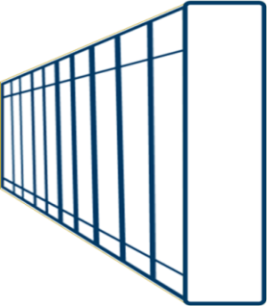
The Changing Datacenter
Traditional Computing
Virtualized Computing
Cloud
Computing
Private Public
Changes in the datacenter
drive changes in IT

Slide 6
Lessons
Friction suppressed the true market demand for Windows Server
Clouds further reduce friction so the number of Servers is going to skyrocket
Managing with a mouse is going to increasing be a strategy for failure

Slide 7
What is Cloud Computing?

Slide 8
What is Cloud Computing?
MVP Summit

Slide 9
What is Cloud Computing?
Real clouds are fuzzy, ill-defined and shifting
With no crisp edges
And hard to get in focus.
So is cloud computing.

Slide 10
What is Cloud Computing?
Architecture gestalt
verses
Business model

Slide 11
What is Cloud Computing?
Architecture gestalt
Elastic and self healing
End-user as admins via self-service portals
Delivering IT as a Service (*aaS)

Slide 12
What is Cloud Computing?
Business model
Buying IT services from someone else
Pay for use
Public vs. private cloud

Slide 13
What is Cloud Computing?
Hybrids make sense
Cloud and non-cloud architectures
Cloud + non-cloud business models

Slide 14
Cloud: IT as a Service

Slide 15
Cloud: IT as a Service
SOFTWARE
as a SERVICE
PLATFORM
as a SERVICE
INFRASTRUCTURE
as a SERVICE
Notes:
One popular conceptualization of the future is It as a Service
Def “work done by somebody for somebody else as a job, duty, punishment, or favor”
Intrinsic to the concept of a Service is management.

Slide 16
Cloud: IT as a Service
Service:
Work done by somebody
for somebody else
as a job, duty, punishment, or favor
Service | By Somebody | For Somebody
SaaS | Vendors (e.g. MSFT) | End Users
PaaS | Vendors (e.g. MSFT) | Developers
IaaS | Vendors or IT | IT, Developers, Testers, End Users

Slide 17
Cloud: IT as a Service
SaaS
End Users
PaaS
Developers
IaaS
IT, Developers, Testers, End Users
Notes:
Let me ground this concept in some specifics
Product mapping
Platform Target Audience
===== =========
Iaas IT Pros
PaaS Developers
SaaS Customers

Slide 18
Cloud? What Cloud?
Deniers
CIO Survey
7 percent “likely use public cloud services”
47 percent “private cloud their first pick”
MVP Summit
~”We don’t need no stinking cloud.”

Slide 19
Cloud, What Cloud?
Denying the cloud is like denying gravity.
Might make an amusing conversation.
But don’t bet your life on it.

Slide 20
Cloud? What Cloud?
Why they are wrong (1):
The “Innovator’s Dilemma”*
* Clayton Christensen

Slide 21
Cloud? What Cloud?
Why they are wrong (2):
Punctuated Equilibria*
* Niles Eldredge and Stephen Jay Gould

Slide 22
Cloud? What Cloud?
Why they are wrong (3):
Subversion

Slide 23
Reality Check
Today’s IT is
the post-facto cleanup
of the mess someone created before us

Slide 24
Quintessence

Slide 25
Quintessence
On-Premise IT
Cloud Business Model
Control
Physical access & security
Configuration and change
Costs
Bandwidth and latency
Elastic and affordable
1 => 10,000 => 1 servers
Inexpensive when you use it
You only pay when you use it

Slide 26
Quintessence
On-Premise IT
Cloud Business Model
Elastic and affordable
1 => 10,000 => 1 servers
Inexpensive when you use it
You only pay when you use it
Control
Physical access & security
Configuration and change
Costs
Bandwidth and latency

Slide 27
Economics Matter
What discount could you get if you
bought 10 servers vs. 1?

Slide 28
Economics Matter
How about 100?

Slide 29
Economics Matter
How about 1,000?

Slide 30
Economics Matter
At 1,000 servers you’d have no choice but to automate
and that would make it
even more economical

Slide 31
Economics Matter
A 1,000 server datacenter
has a much more lower TCO/Server
than a 100 server one

Slide 32
Economics Matter
Sounds compelling … right?

Slide 33
Economics Matter
But wait ….

Slide 34
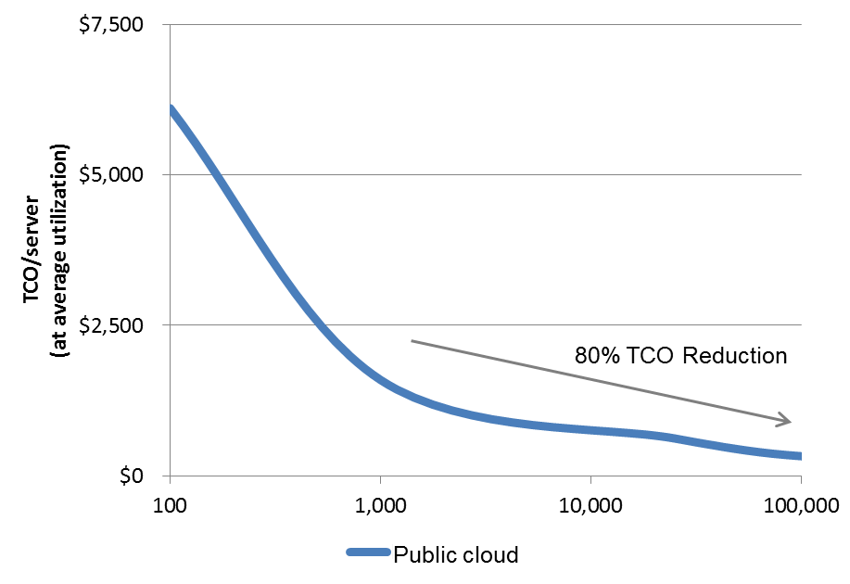
Size Matters in Economics*
* The Economics of the Cloud By Rolf Harms and Michael Yamartino
A 100,000 server datacenter has
80% lower TCO
than a 1,000 server one

Slide 35
“Technologies that matter are the ones that produce a compelling economic advantage.” Jeffrey Snover

Slide 36
Denying the cloud is like denying gravity
Might make you popular at a party
But don’t bet your livelihood on it.

Slide 37
What then must we do?*
Study and understand the cloud
Analyze its intrinsic characteristics
Refine our professional value proposition
*Tolsoy

Slide 38
Automation is the Heart of Cloud
Cloud requires tight integration of servers, networking, storage, OS, middleware and applications
Dynamic provisioning, configuration, monitoring, fault recovery, management

Slide 39
Automation is the Heart of Cloud
“Site Up” focus drives continuous improvement
Failures produce additional automation
“We will audit our change process and increase the automation to prevent this mistake from happening in the future.” – Amazon Service Disruption

Slide 40
Automation enables the public cloud business model

Slide 41
Public Cloud Business Model
Automation the primary factor in super high server/admin ratios
Automation in the large requires standardization
Standardization further lowers costs
Automation is what enables Self-Service Portals

Slide 42
Automation enables the public cloud business model AND . . . .

Slide 43
AND…
People are expensive
People break stuff
Therefore, in the cloud business model, anything that requires people needs to be minimized to
Minimize costs and service disruptions

Slide 44
Public cloud still needs local admins
Fewer and with a polarized set of skills

Slide 45
Automation enables the public cloud business model BUT . . . .

Slide 46
It is optimized to deliver a relatively small set of standardized scenarios

Slide 47
Why?
Because variations require people
People are expensive
People screw things up

Slide 48
Sound familiar?

Slide 49
“Any customer can have a car painted any color that he wants so long as it is black.” Henry Ford

Slide 50
Is this the end of local servers and admins?
Maybe
Maybe not

Slide 51
McDonalds verses tailored clothing

Slide 52
Highly differentiated solutions compete nicely
If they are in the ballpark
However, much of IT today is not in the ballpark

Slide 53
Highly differentiated IT is not about clicking a mouse faster or for more hours.

Slide 54
Highly differentiated IT is not about getting more out of your old software and servers.

Slide 55
Highly differentiated IT is not about laying off admins.

Slide 56
Highly Differentiated IT
IT that advances the business
Delivering the best functionality
The way that business needs it
With continuous availability
At a low cost
With the agility to respond quickly to changing needs

Slide 57
Highly Differentiated IT
Delivering the best functionality
Do you understand your companies business?
Do you understand the competitors and what they do for IT?
How often do you meet with non-IT?
Are you responding to their requests or proposing solutions to advance the business?

Slide 58
Highly Differentiated IT
The way that business needs it
Do you support the companies processes?
Do you bridge the natural islands of isolation that hurt the business and cause manual steps?
Are you up to speed on how to run IT in a way that will withstand an Compliance Audit?

Slide 59
Highly Differentiated IT
With continuous availability
Have you had a business continuity discussion?
Do you have a disaster recovery plan?
Are you clustering?
Do you have a change management process?

Slide 60
Highly Differentiated IT
At a low cost
Are you automating operations?
Are you leveraging virtualization to drive up utilization?

Slide 61
Highly Differentiated IT
With the agility to respond quickly to changing needs
Are you solving point problems or building tools, systems and skills?
Do you know how to leverage the community to solve problems?
Does the community owe you any favors?

Slide 62
Ok – so how do we do that?

Slide 63
Highly Differentiated IT
Engage in the your companies business
Update to the latest versions
Follow a three step program
Automate
Automate
Automate

Slide 64
Automation enables the public cloud business model AND . . . . Automation enables highly differentiated IT

Slide 65
The Good News
Microsoft’s distinct competence is in taking high end computing and making it doable by the masses
We are doing that for automation

Slide 66
Automation == PowerShell
PowerShell is NOT a CLI or a Shell
PowerShell is a distributed automation engine with a CLI and a Shell

Slide 67
PowerShell
Distributed automation engine exposed as:
An interactive shell
A scripting language
An API
A remoting interface
Cmdlets
Coverage is king
WMI, WSMAN, COM, .Net, ADSI, XML, native code …
Common Engineering Criteria
3rd party support

Slide 68
Success Stories
Bourbon Street
TechEd Inventory

Slide 69
But wait – it gets even better

Slide 70
In the past, Windows Server has been a great OS for a server and its devices

Slide 71
Windows Server 8 is a great OS for lots of servers and the devices connecting them whether they are physical or virtual whether they are on-premise or off

Slide 72
And secure, robust multi-machine automation is at the heart of Windows Server 8

Slide 73
Multi-Machine Server Manager
Robust Connections
Automation
WMI V2 Provider Model
PowerShell V3
Task Scheduler Cmdlets
>2330 Cmdlets
Remote Role Install & Config
Supports latest CIM and WSMAN standards
Simplified Script Authoring
Fast scripts using DLR
Secure Multi-machine Workflows
New WMI Providers for security, storage, networking, virtualization

Slide 74
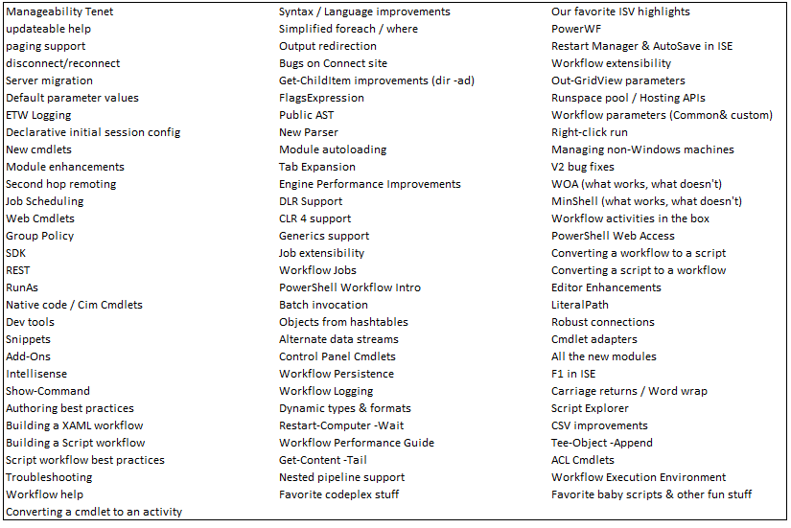
PowerShell V3 Features

Slide 75
Economics Matter
Windows Server 8 will be the easiest OS To automate To build public and private clouds And deliver highly differentiated IT

Slide 76
Call to Action
Upgrade to the latest versions
Invest in automation skills
Engage in the community

Slide 77
Thank you.

Slide 78
Your Feedback is Important
Please fill out a session evaluation form drop it off at the conference registration desk.
Thank you!

